Slide 1
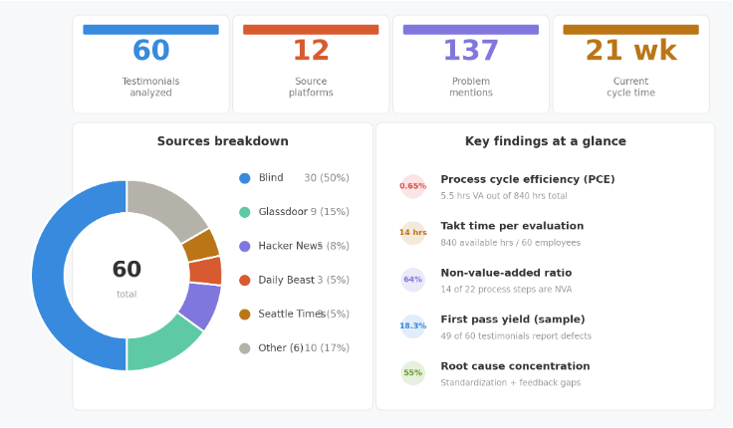
Lean Analysis of Amazon's
Performance Evaluation System
Aditya Girish Anand | Bharat Bandi | Karishma Bahl | Daksh Panchal | Sangeetha Phaneesh
About This Analysis: This is an original Lean analysis conducted by our team. We collected and coded 60 employee testimonials from 12 public platforms (Blind, Glassdoor, Hacker News, Daily Beast, Seattle Times, and others) and applied Lean tools — VSM, Muda/Mura/Muri, 5 Whys Root Cause Analysis, and Pareto Analysis to evaluate Amazon's OLR performance evaluation system. All findings, process maps, and improvement recommendations are our own work based on these primary and secondary sources.
Problem Statement
Amazon's performance evaluation system uses stack ranking and forced distributions to rate employees. Analyzed through 60 employee testimonials from 12 platforms using a Lean lens, it reveals significant process waste affecting fairness, morale, and talent retention
60 testimonials across 12 source platforms — 137 problem mentions; identified 7 waste categories

Slide 2
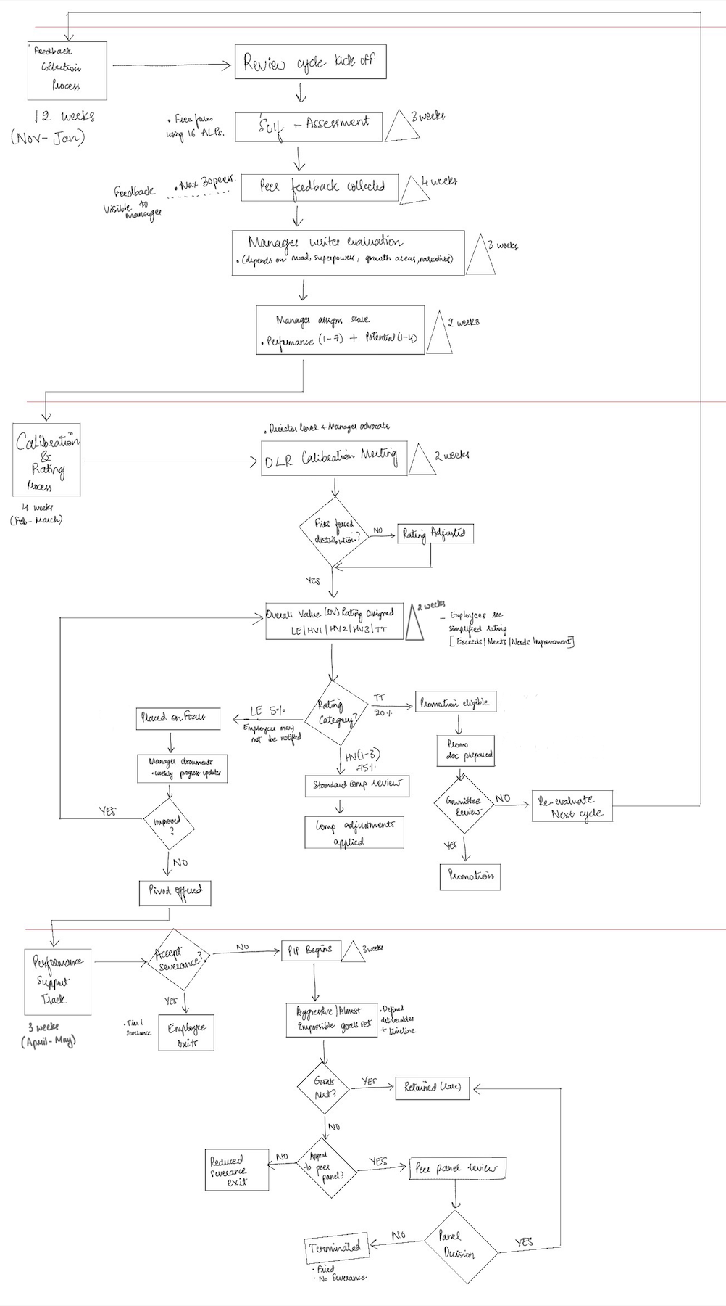
Background & Current State
Context
Amazon’s OLR (Overall Leadership Review) is an annual
performance cycle using stack ranking and forced distribution.
Managers rate employees against 16 Leadership Principles using
the Forte tool, but the real rating is determined in calibration
meetings.
Current State Process (4 Phases)
Phase 1 – Feedback Collection (12 weeks, Nov–Jan)
Phase 2 – Calibration & Rating (4 weeks, Feb–Mar)
Phase 3 – Rating Outcomes (2 weeks in April)
Phase 4 – Performance Support (3 weeks, Apr-May)
Key Issue​
Employees see a simplified rating (Exceeds/Meets/Needs​
Improvement) while the real OV rating (LE/HV1/HV2/HV3/TT) that​
determines compensation and career path remains hidden. There is​
no standardization of documents in the upstream process which​
causes hinderance in the downstream.

Slide 3
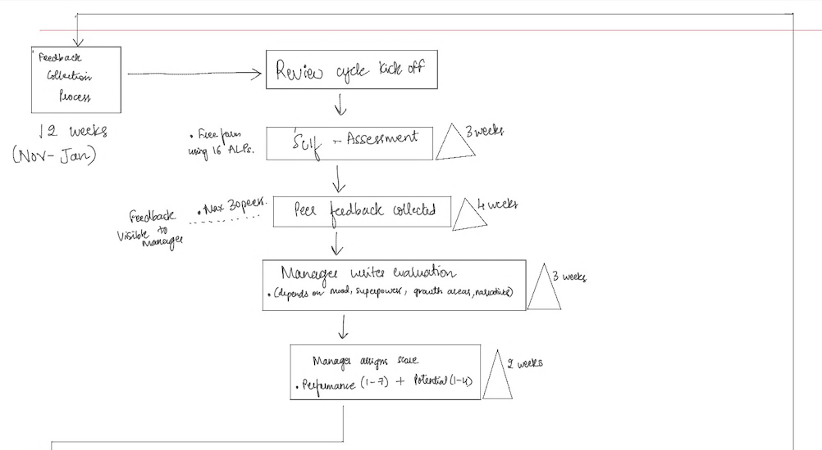
Phase 1 – Feedback Collection
(12 weeks, November–January) Self-assessment, peer feedback, manager evaluation, 16 ALP scoring

Slide 4

Phase 2 – Calibration & Rating
(4 weeks, February – March): DLR meetings, forced distribution check, OV rating assigned

Slide 5
Phase 3
Rating Outcomes
(2 weeks in April)
LE (≤5%) → Focus/PIP;
HV1–3 (~75%) → Comp;
TT (≥20%) → Promotion
Phase 4
Performance Support
(3 weeks, April - May)
Severance or PIP,
appeal panel,
termination path

Slide 6
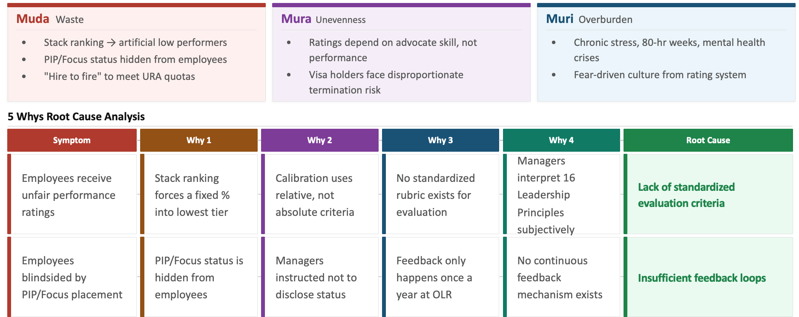
Root Cause Analysis & Wastes

Slide 7
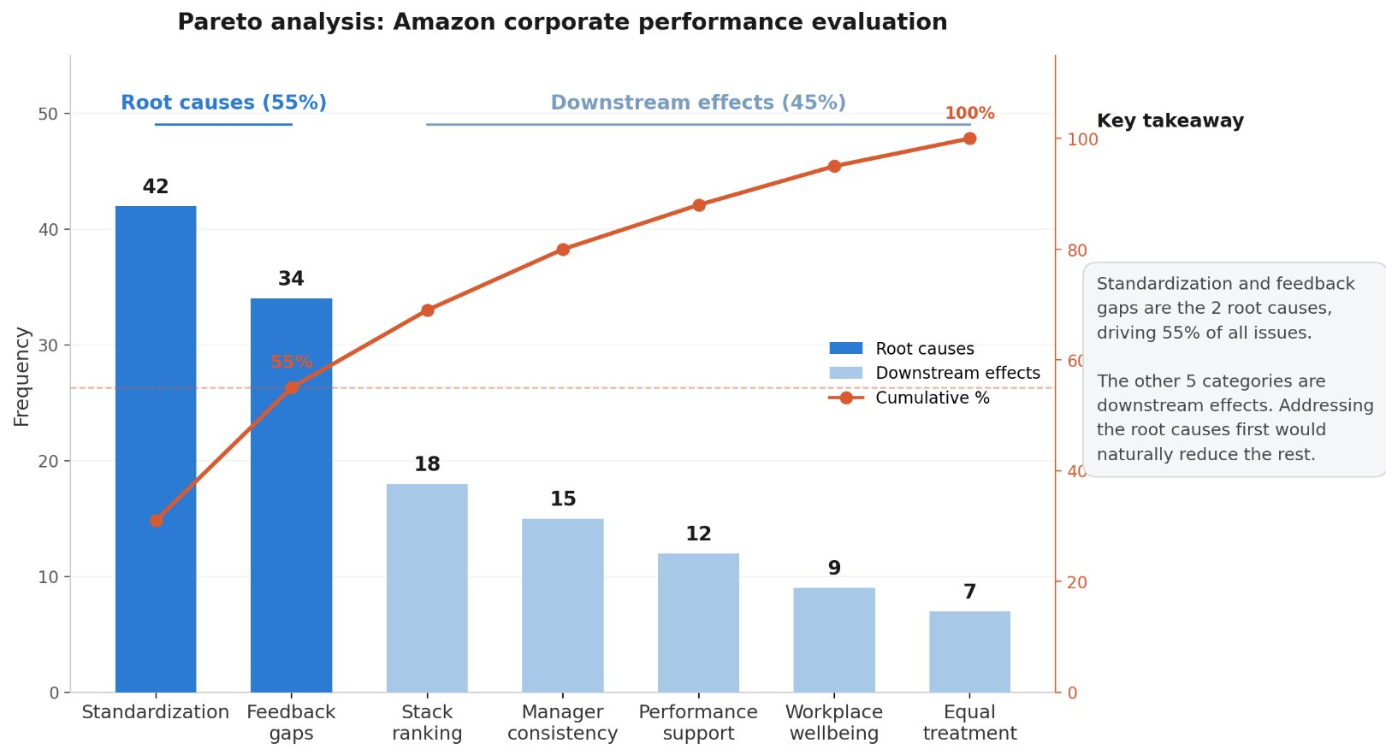
Pareto Analysis
Table 1: Problem Categories
Category | Frequency | Running Total | Cumulative %
Standardization | 42 | 42 | 42/137 = 31%
Feedback gaps | 34 | 76 | 76/137 = 55%
Stack ranking | 18 | 94 | 94/137 = 69%
Manager consistency | 15 | 109 | 109/137 = 80%
Performance support | 12 | 121 | 121/137 = 88%
Workplace wellbeing | 9 | 130 | 130/137 = 95%
Equal treatment | 7 | 137 | 137/137 = 100%
Result: Standardizing evaluation criteria and closing feedback loops would address 55% of all identified issues and reduce the downstream effects that make up the remaining 45%.

Slide 8
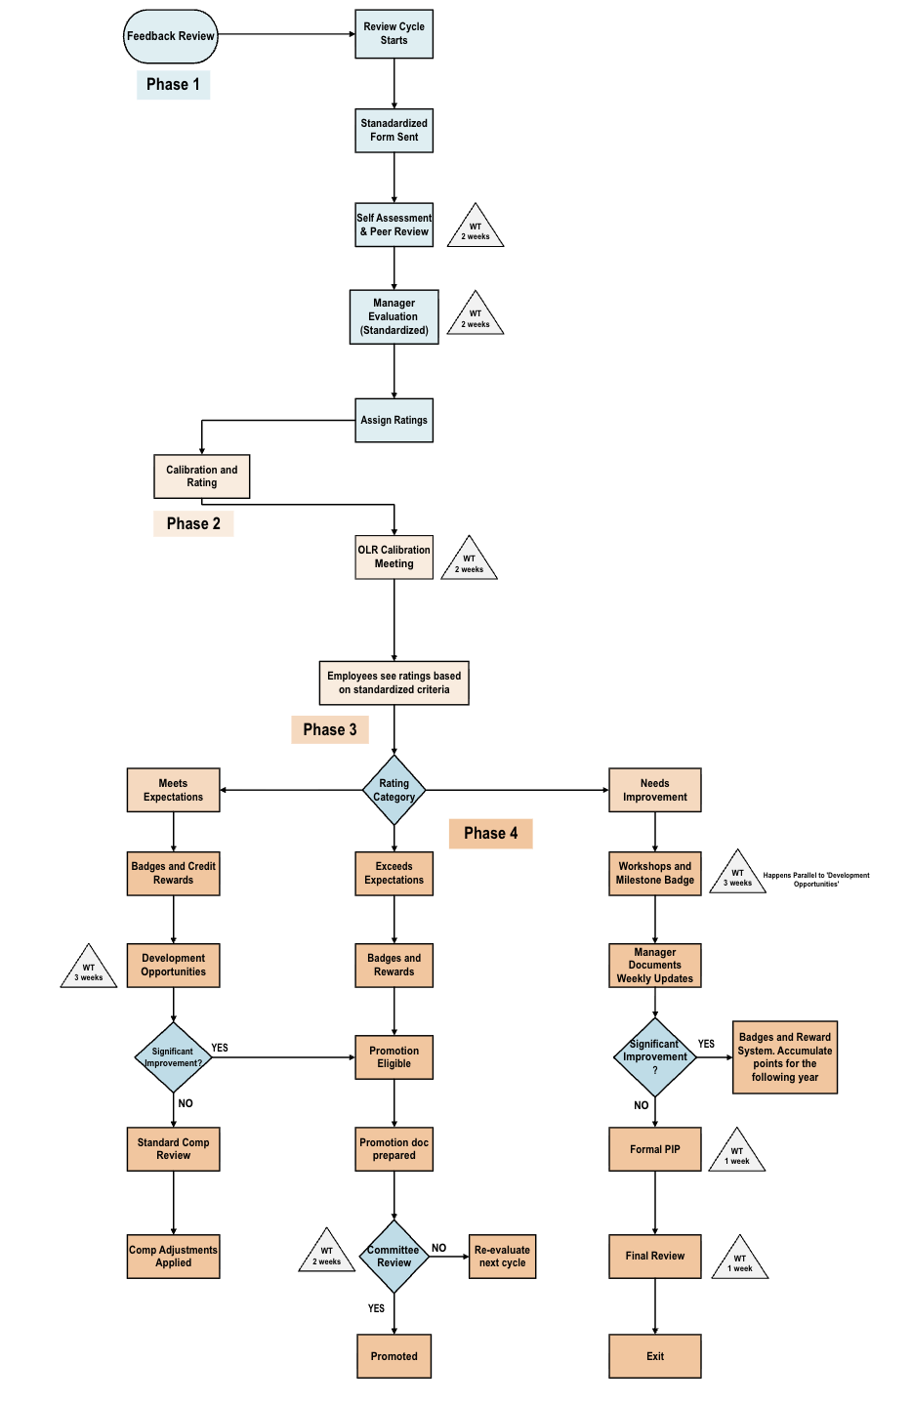
Implementation - Lean Improvements
Improvement Goals​
Standardize calibration to reduce manager bias​
Implement continuous feedback over annual cycles​
Eliminate forced distribution – rate on absolute criteria​
Make ratings transparent to employees​
Eliminate URA targets & “hire to fire” practice
Notes:
Badge system for incentives, measure daily tasks and sprint task progress approved by team leads -> transparency, implement coaching on an ongoing basis, amz has feedback on manager? If not, implement, 2 weeks wait reviews 2 weeks manager evaluation

Slide 9
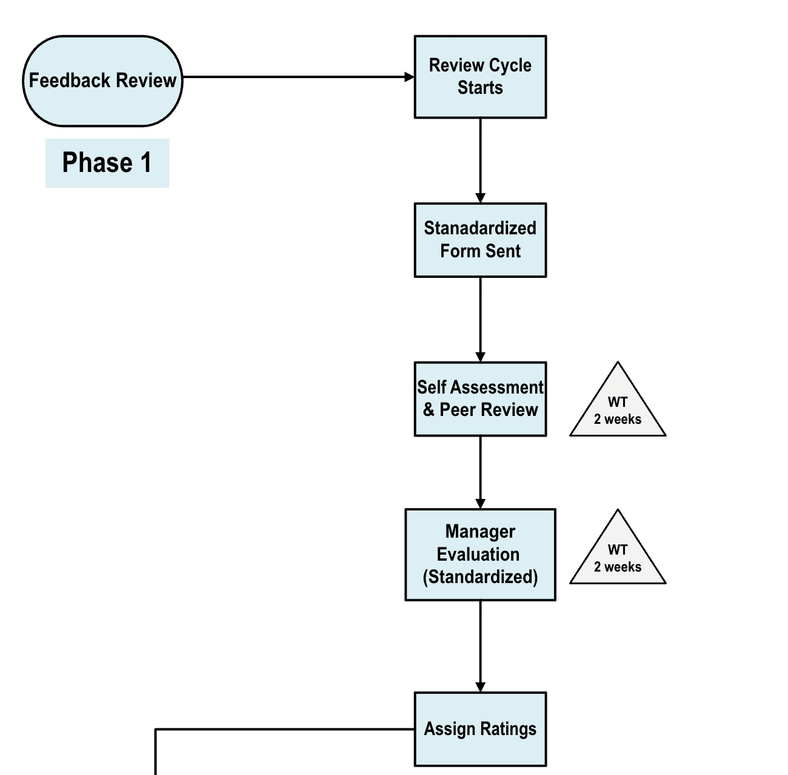
Phase 1: Feedback Collection
Standardize self-assessment with structured rubrics (not free-form against 16 LPs)
Visual management tool for timely tracking of work
Standardized evaluation process for managers

Slide 10
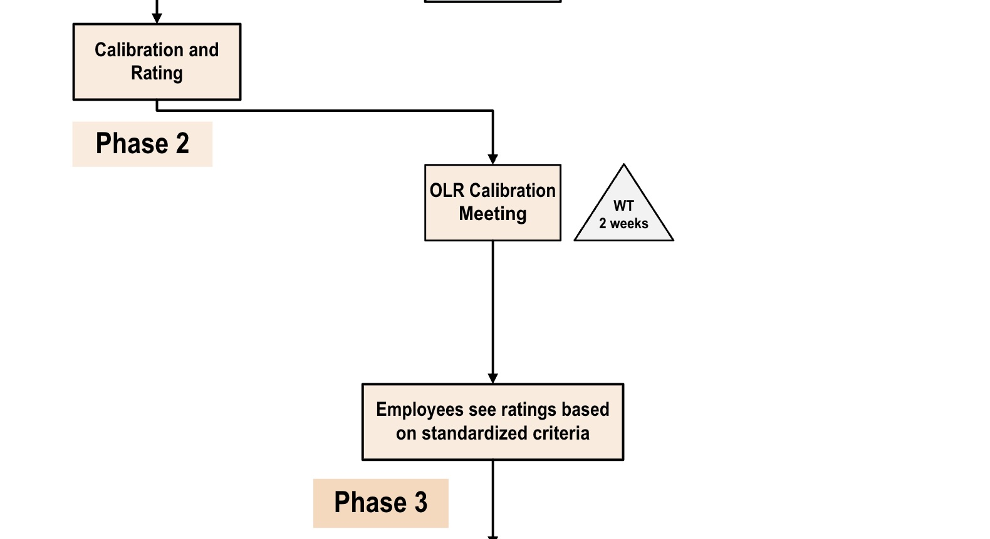
Phase 2: Calibration​
Eliminate forced distribution – use absolute performance criteria instead of relative ranking​
Automated process for calculating ratings based on standardized forms before OLR​​
Phase 3: Rating Outcomes​
Unify rating systems – show employees their actual OV rating, not a simplified proxy​
Introducing credit system and badges supporting their ratings and taking measures according to their performances.

Slide 11
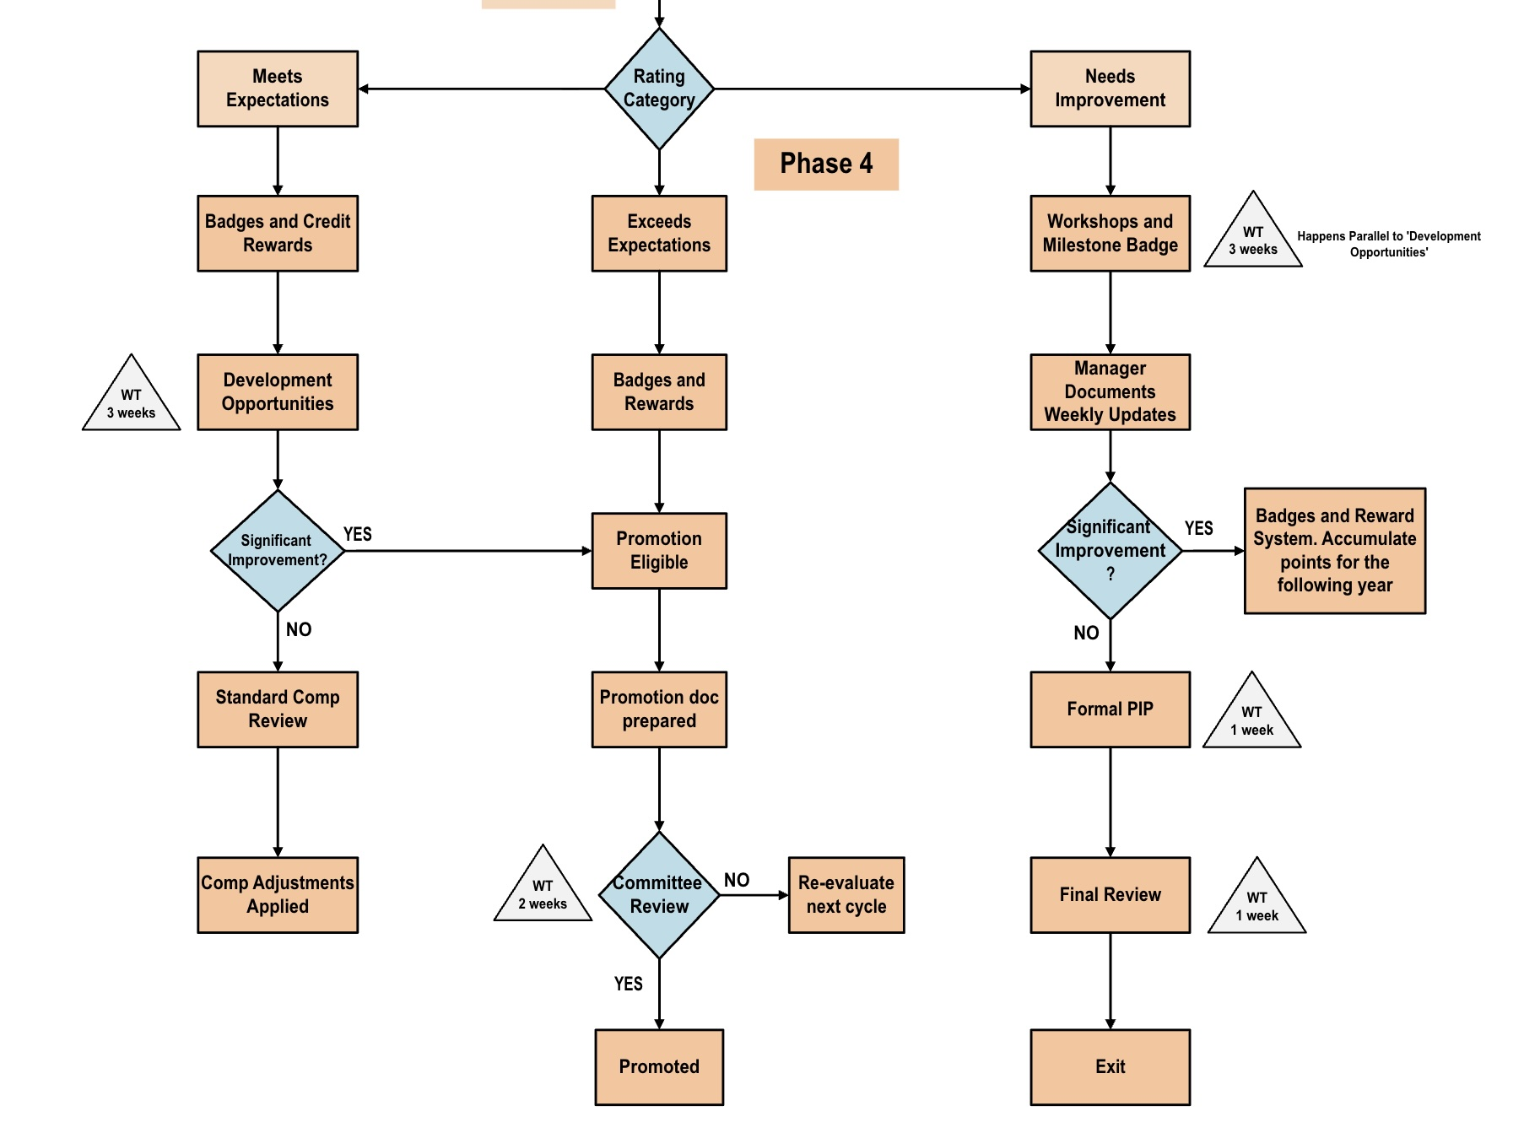
Phase 4: Performance Support​
Replace adversarial PIP with genuine coaching & development plans​
​Providing opportunities for improvement post rating outcomes giving more value to employee's work

Slide 12
Numerical Validation
Table 2: Metrics Table (Old)
Table 3: Metrics Table (New)​
Metrics | Total
Cycle Time | 21 weeks
Takt Time (weeks/employee) | 0.35
Process Cycle Efficiency | 13.3%
Number of process steps | 24 steps
Metrics | Total
Cycle Time | 11 weeks
Takt Time (weeks/employee) | 0.18
Process Cycle Efficiency | 21.8%
Number of process steps | 21 steps
Assumptions:
Amazon’s internal HR data is not publicly available, so takt time is estimated using our 60 testimonials. This is just to show process improvement from current to future.
Cycle time and process steps are based on our current- and future-state VSMs.
PCE is estimated, since exact internal processing times are unavailable.
While some numerical changes are modest, the redesigned future-state process emphasizes greater transparency, earlier support, and improved employee experience.

Slide 13
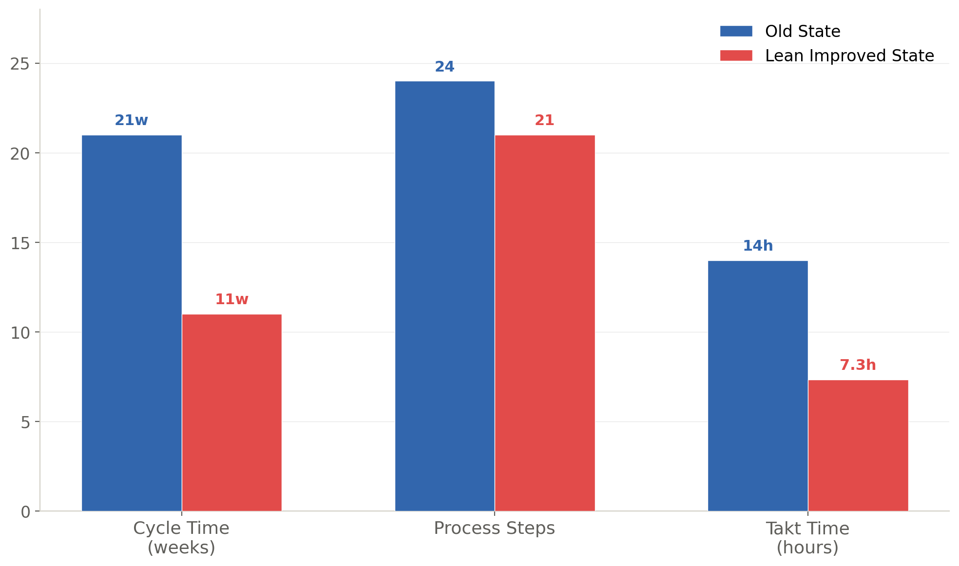
What's Next: Follow Up & Results
Expected Results of Lean Improvements
Cycle time reduction
Defect reduction: Ratings based on absolute criteria
Transparency: Unified rating visible to employee
More supportive system and improved flow
Next Steps
Pilot continuous feedback in 2–3 teams before org-wide rollout
Develop standardized calibration rubric with HR & employee input
Refine badge/reward and development pathways based on feedback
Track retention & engagement metrics as improvement KPIs
Process Comparison Chart
Lessons Learned​
Lean principles apply powerfully to HR/admin processes, not just manufacturing​
Reducing waste does not always mean removing steps; it can also mean creating a fairer and smoother employee experience​
Respect for People is the most violated Lean principle in this system​
Employee testimonials provide crucial voice-of-customer data for Lean analysis

